Slide 1
Graph III

Slide 2
GRAPH REPRESENTATION

Slide 3
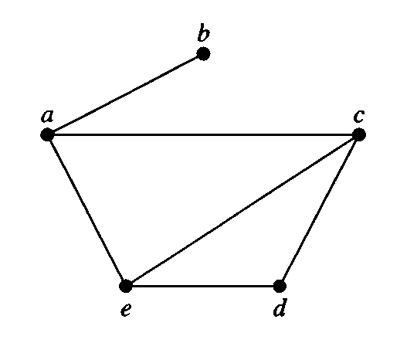
GRAPH REPRESENTATION
Adjacency list

Slide 4

GRAPH REPRESENTATION
Adjacency list
Vertex Adjacent vertices
$a$ $b,c,e$
$b$ $a$
$c$ $a,d,e$
$d$ $c,e$
$e$ $a,c,d$

Slide 5
GRAPH REPRESENTATION
Adjacency list
Vertex Adjacent vertices
$a$ $b,c,e$
$b$ $a$
$c$ $a,d,e$
$d$ $c,e$
$e$ $a,c,d$

Slide 6
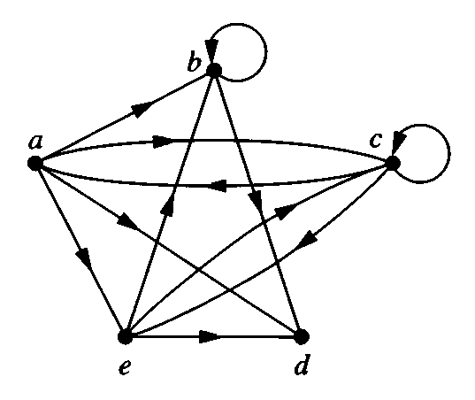

GRAPH REPRESENTATION
Adjacency list
Initial Terminal vertices
$a$ $b,c,d,e$
$b$ $b,d$
$c$ $a,c,e$
$d$
$e$ $b,c,d$

Slide 7
GRAPH REPRESENTATION
Adjacency list
Initial Terminal vertices
$a$ $b,c,d,e$
$b$ $b,d$
$c$ $a,c,e$
$d$
$e$ $b,c,d$

Slide 8

GRAPH REPRESENTATION
Adjacency matrix
$$\begin{matrix} & \begin{matrix}a & b & c & d & e\end{matrix} \\ \begin{matrix}a \\ b \\ c \\ d \\ e\end{matrix} & \left[\begin{matrix}0 & 1 & 1 & 0 & 1 \\ 1 & 0 & 0 & 0 & 0 \\ 1 & 0 & 0 & 1 & 1 \\ 0 & 0 & 1 & 0 & 1 \\ 1 & 0 & 1 & 1 & 0\end{matrix}\right]\end{matrix}$$
What would happen if more than one edge between two vertices?

Slide 9
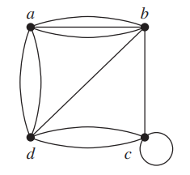
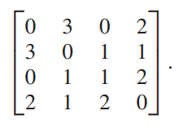
GRAPH REPRESENTATION
Adjacency matrix
a
b
c
d
a
b
c
d

Slide 10

GRAPH REPRESENTATION
Adjacency matrix
$$\begin{matrix} & \begin{matrix}a & b & c & d & e\end{matrix} \\ \begin{matrix}a \\ b \\ c \\ d \\ e\end{matrix} & \left[\begin{matrix}0 & 1 & 1 & 1 & 1 \\ 0 & 1 & 0 & 1 & 0 \\ 1 & 0 & 1 & 0 & 1 \\ 0 & 0 & 0 & 0 & 0 \\ 0 & 1 & 1 & 1 & 0\end{matrix}\right]\end{matrix}$$

Slide 11
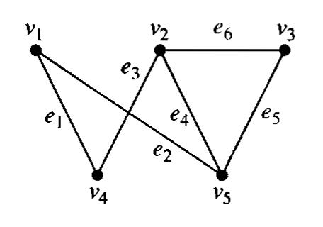
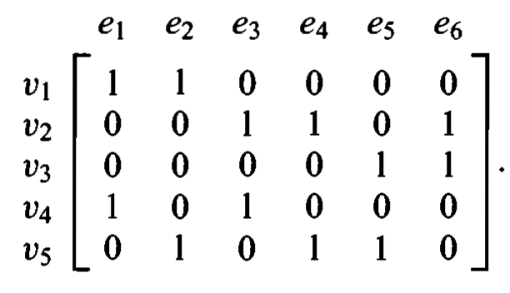
GRAPH REPRESENTATION
Incidence matrix

Slide 12
Thank You

